Slide 1
Learning Research Skills (and others) by doing research: The Onion Project No onions were harmed in this work
Duane Mellor PhD RD & Adetokunbo Osho MSc RNutr.
Clinical Sciences and Nutrition
University of Chester

Slide 2
Overview of Session
Background
Aims of the project
The project plan
Real or Photo?
The layers…
Successes and Challenges
What next?

Slide 3
The Study Team
Duane Mellor – Senior Lecturer Nutrition and Dietetics
Adetokunbo Osho – Demonstrator and Visiting Lecturer
Second year undergraduate students on Nutrition and Dietetics and Human Nutrition programmes

Slide 4
Initial Questions
What skills do nutritionists and dietitians need to use to discuss food and health?
Knowing how to estimate portion size?
Being able to teach others portion size estimation?
Research and data handling skills?

Slide 5
Estimate the portion sizes of the items on the table!!!

Slide 6
Try to Guess the portion size (Small, Medium or Large, portion weight and energy content of these samples of pasta and rice)
Food/ Picture | Portion Size | Portion Weight (g) | Energy Content (Kcal)
Pasta Picture
Rice Picture
Real Pasta Cooked
Real Rice Cooked
Real Pasta Dried
Real Rice Dried
Model Rice
Model Pasta

Slide 7
Background – The University of Chester
Department of Clinical Sciences and Nutrition
Two UG courses – Human Nutrition and Nutrition and Dietetics
Portfolio of PG courses in areas of health, nutrition and physical activity
Holds contract with NHS (LETB) to train dietetic students in NW England

Slide 8
Background – Our Students
Level 5 UG Students
Nutrition and Dietetics students prior going on their A placement in the NHS
Human Nutrition students prior to going on their work-based learning – public and private sector
A wide range of abilities
Students taught topics from cell biology and biochemistry to the psychology and sociology of behaviour

Slide 9
Background The Module: Research Methods
To equip students with skills required to locate and critically analyse primary research papers or appropriate media presentations
To provide an understanding of the essential processes involved when conducting good scientific research
To expose students to the importance of ethical and sustainable development considerations when conducting research in any discipline

Slide 10
Aims of the Project
Know how / Show how
For students to learn how to estimate portion sizes
For students to device best methods on how to teach estimation of portion sizes
For students to design a simple randomized study
For students to learn how to statistically analyze results obtained and interpret their findings

Slide 11
The Project Plan
Determination of study aims
Determination of study objectives
Determination of best study design : Randomized Trial
Determination of intervention/s (control???)
Sources of confounding (limited or not???)
Application for ethical approval

Slide 12
Subjects were randomized into 2 groups
Picture group and Real food group
The picture group acted as participants for the Real food group and vice versa
Statistical analysis to test for significant difference in the both groups
Project report/reflection

Slide 13
Introduction to project
Planning
Photograph preparation
Preparation and training
Training in presenting foods for assessment within group
36 foods
Training in presenting foods for assessment within group
Training in presenting photos for assessment within group
36 photos
Baseline Assessment
Baseline Test with 12 randomly selected foods
Using participants
Baseline Test with 12 randomly selected photographs
Using participants
Training Session
Training session all foods
Using participants
Training session all photographs
Using participants
Post training Assessment
Follow up assessment of 12 randomly selected foods
Using participants
Follow up assessment of 12 randomly selected photos
Using participants

Slide 14
Layout and flow around the food skills laboratory
8
9
10
11
12
7
6
5
Key: Hob
Sink
Sample food
4
3
2
1

Slide 15
Proposed foods for testing Each was presented as either small/ medium or large portions (Note: the size of the portion were randomised, not the food)
Mashed potato
Boiled rice
Pasta/ spaghetti
Jam on toast
Cornflakes/ Rice Krispies
Porridge
Sausages
Baked beans
Mixed vegetables
Cheese
Sliced meats
Crisps

Slide 16
Intervention: Real or Photo?
Back to the quiz…
Food / Picture | Portion Size | Portion Weight (g) | Energy Content (Kcal)
Pasta Picture | Small | 150 | 250
Rice Picture | Large | 290 | 400
Real Pasta Cooked | Medium | 245 | 415
Real Rice Cooked | Medium | 200 | 235
Real Pasta Dried | Large | 170 | 590
Real Rice Dried | Small | 65 | 140
Model Rice | Small | 170 | 140
Model Pasta | Small | 150 | 250
Notes:
Consider plastic foods and samples of pasta or rice with DAFNE etc as models

Slide 17
The Layers – Research Skills
Planning studies
Carrying out studies – logistics of having things in the right place at the right time
Costs and resources
Permissions and ethics
Managing participant involvement
Developing and then following a protocol – data collection and teaching

Slide 18
The Layers – Portion Size Estimation
Key skill in the dietetic curriculum from the British Dietetic Association
Need it to assess and education patients
In industry to make estimates of quantities in food manufacture and product development
Research tool in estimating food intake

Slide 19
The Layers – Teaching Skills
Nutrition is a knowledge transfer science – key is to educate the general public
Safe place to test and develop lesson plans and teaching – before placements
Key of consistency same message delivered but adapted to the individual

Slide 20
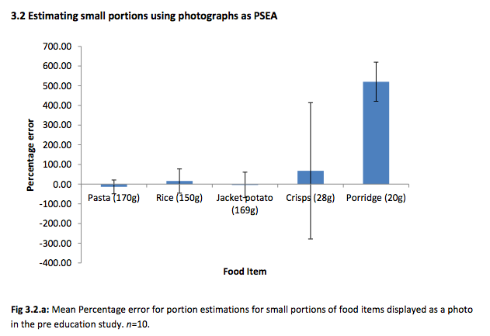
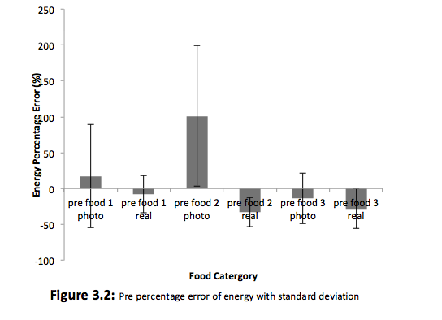
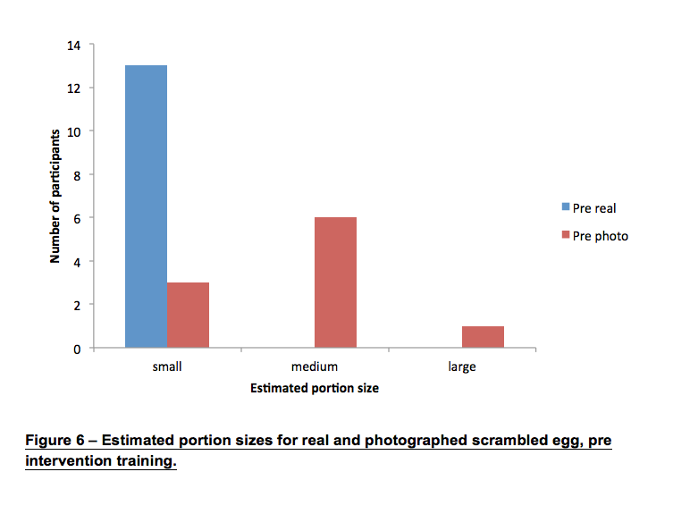
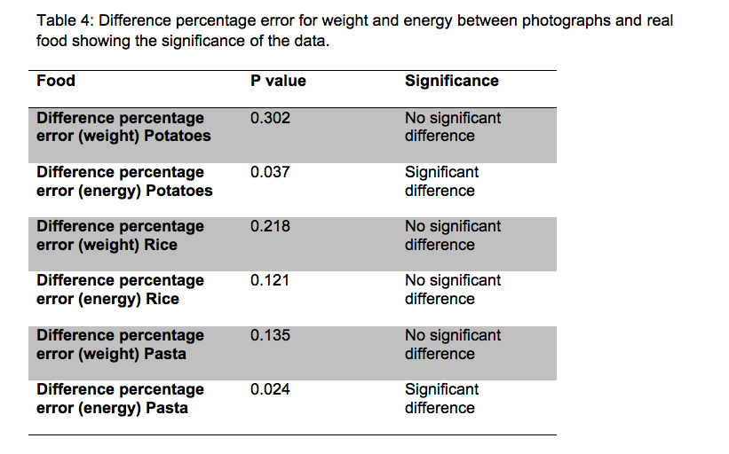
The Layers – Data Analysis

Slide 21
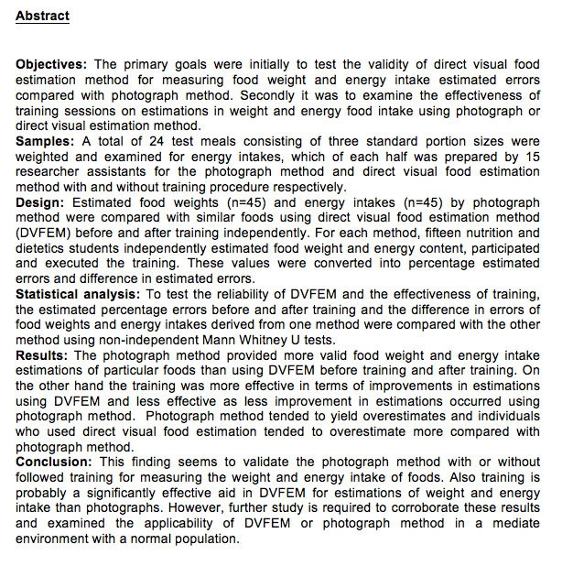

Slide 22
Successes and Challenges
It was difficult to allow the students make mistakes
Design included avoidable sources of confounding factors
Key was the development of an understanding of research process, not necessarily delivering a robust study design

Slide 23
What Next?
For the next cohort – do we reduce the level of confounding factors (or let the students decide)?
Work-based learning students to develop resources for teaching portion sizes
Consider other nutrients relevant to clinical situations – Carbohydrate and Diabetes or Protein and Kidney Disease

Slide 24
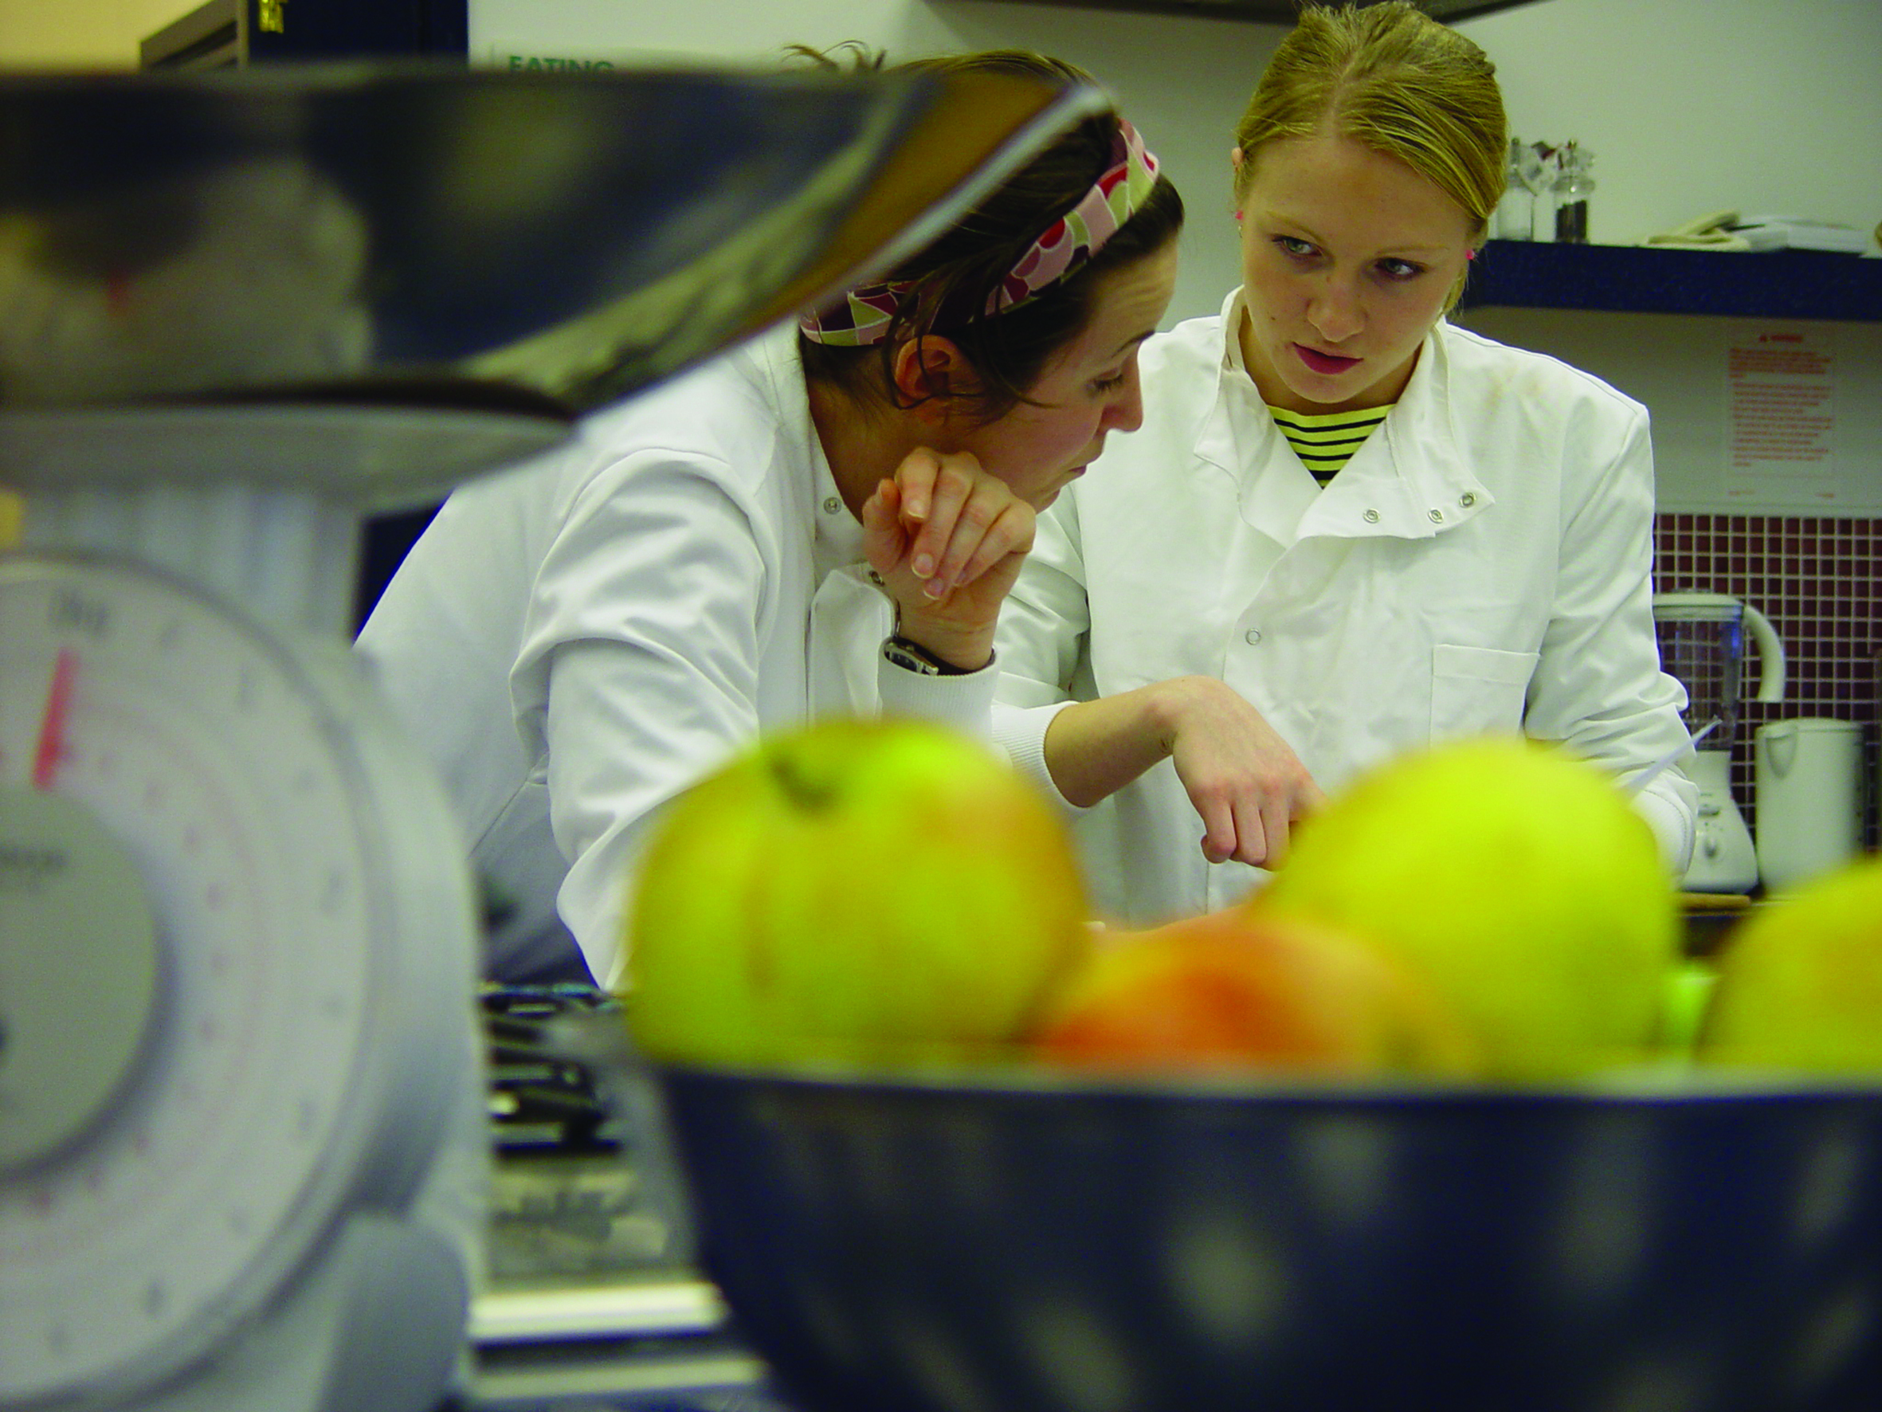
Thank You for Listening Any Questions?

