Slide 1
Oral History Student Research and OER production: Political and Educational Considerations around the OpenLIVES Pedagogy
School of Modern Languages and Cultures
FACULTY OF ARTS
Antonio Martínez-Arboleda
Principal Teaching Fellow in Spanish
Student as Producer Conference
University of Lincoln - 26 June 2013
©University of Leeds

Slide 2
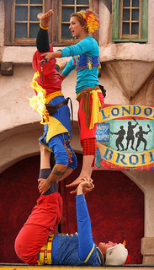
School of Modern Languages and Cultures
FACULTY OF ARTS
The OpenLIVES Project
Educational and Political Discoveries (Student as Producer)
Oral History
Student Production
Life Skills

Slide 3
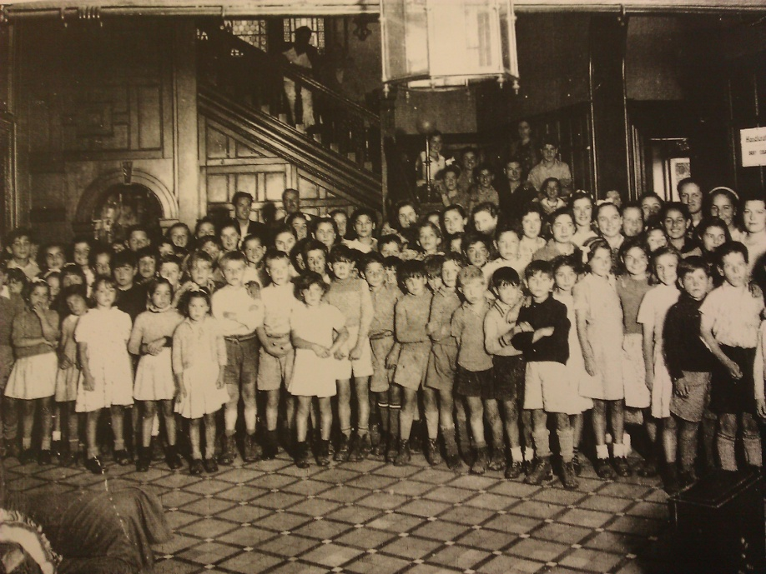
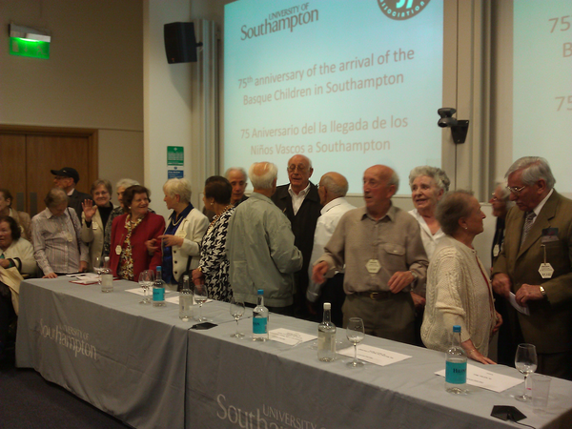
School of Modern Languages and Cultures
FACULTY OF ARTS
Alicia Pozo-Gutierrez, University of Southampton, “Tales of return: The memories and experiences of Spanish returnee migrants from France and Great Britain (1950s-1990s)”
OpenLIVES project (2012). An open collection of research data and teaching materials relating to Spanish migrant stories. JISC
OpenLIVES project (2012). An open collection of research data and teaching materials relating to Spanish migrant stories. JISC

Slide 4
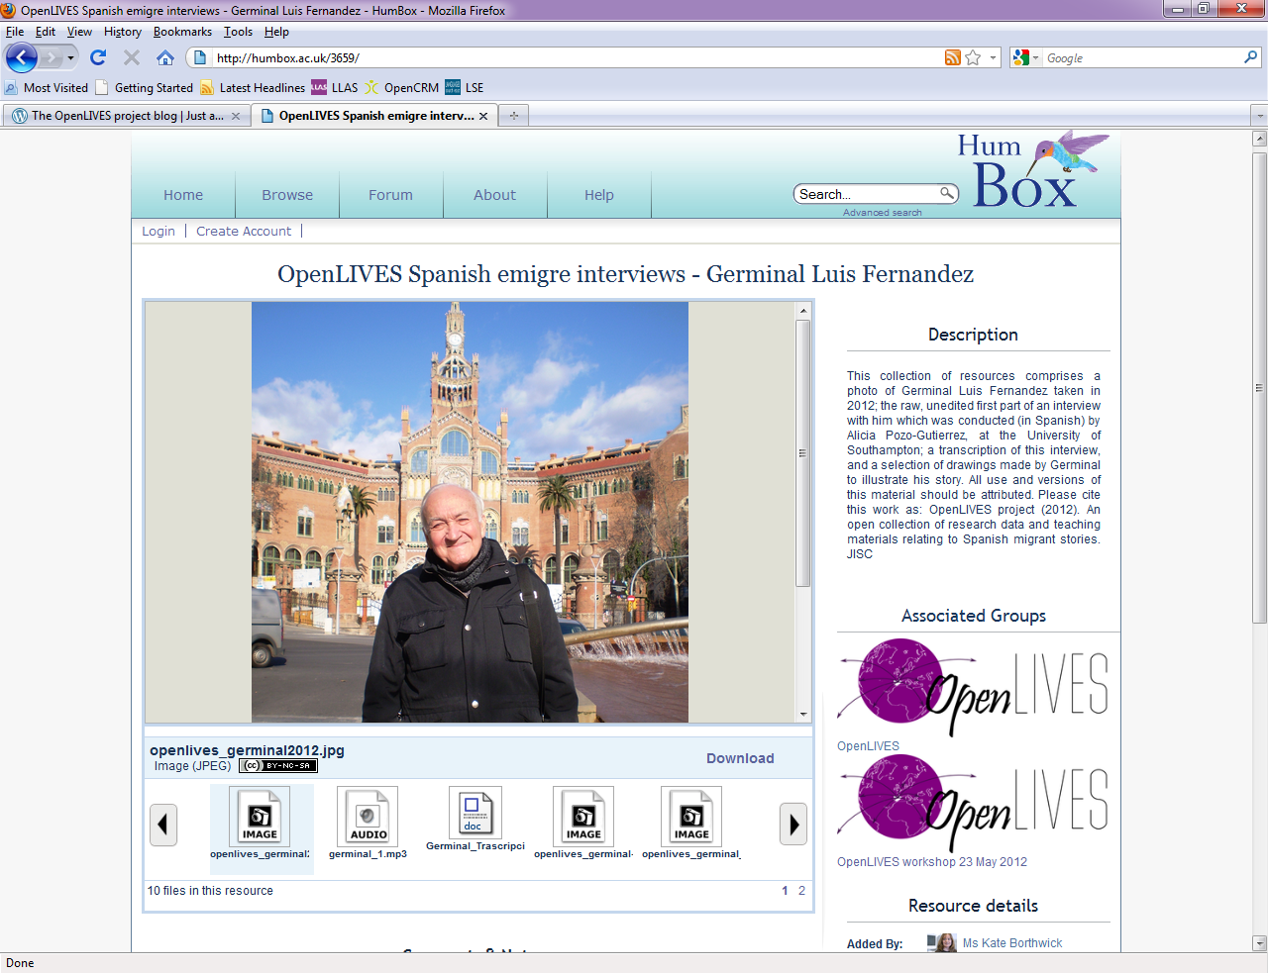
School of Modern Languages and Cultures
FACULTY OF ARTS
OpenLIVES Leeds: The Final Year Module

Slide 5
School of Modern Languages and Cultures
FACULTY OF ARTS
Main Student-Produced Outcomes
A series of brand-new life story interviews with Spanish economic migrants who live in Leeds. These interviews are conducted in Spanish by the students (one interviewee per each three students). They are meant to be digitised and shared as OER by the students themselves at the end of the course, although they are carried out half way through the course. These outputs are not formally assessed.
A 2,500 words (around 20 minutes) audio documentary in Spanish, one per student, to be submitted in its final version at the end of the course. The documentary incorporates soundtracks from the original OpenLIVES collection of interviews as well as from any brand new interviews conducted by the students themselves. The draft script of the documentary counts 40% towards the overall mark of the module; the second and final version, submitted in an audio file following feedback on the draft script, is submitted in an audio file and counts 30%.

Slide 6
School of Modern Languages and Cultures
FACULTY OF ARTS
Some specific skills in OpenLIVES
This module is aimed at enabling students to become responsible digital scholars. At the end of the course, students should feel prepared to make tangible and socially purposeful contributions to the Global Community. In order to fulfil this greater goal and support student production, the module intends to provide students with skills in the following areas:
• oral history interviewing and coding (research methods);
• documentary scripting and production, including using the software Audacity;
• OER literacy, including publishing and licensing;
• team work and project management;
• Spanish language for specific purposes

Slide 7
School of Modern Languages and Cultures
FACULTY OF ARTS
Contents in OpenLIVES
The module also promotes critical and ethical understanding of all the social, epistemological and educational issues connected to their research and production work carried out by students. This means that the teaching programme also touches upon the following areas:
OER and open practice from a social, educational and political point of view;
economic migration in Spain in the 21st century, mainly in comparison with 1960’s economic migration;
the economic, political and social situation in contemporary Spain;
ethical protocols for research;
oral history, from a social, scientific and ethical point of view;
modes of expression and the documentary genre;

Slide 8
School of Modern Languages and Cultures
FACULTY OF ARTS

Slide 9
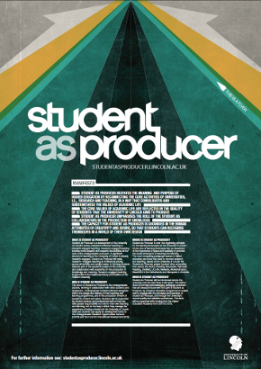
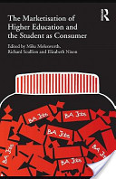
School of Modern Languages and Cultures
FACULTY OF ARTS
Educational and Political Discoveries
Molesworth, M., Scullion, R., and Nixon, E. (eds) (2011). The Marketisation of Higher Education and Student-as-a-consumer. Routledge. London and New York.

Slide 10
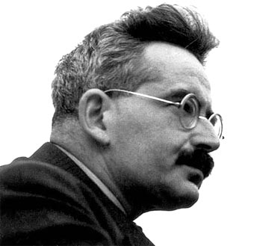
School of Modern Languages and Cultures
FACULTY OF ARTS
Educational and Political Discoveries
The “bourgeois apparatus of production and publication can assimilate an astonishing number of revolutionary themes, and can even propagate them without seriously placing its own existence or the existence of the class that possesses them into question” Benjamin, W. (1934)
www.biografiasyvidas.com
http://www.internationalgramscisociety.org/about_gramsci/photo_archive/

Slide 11
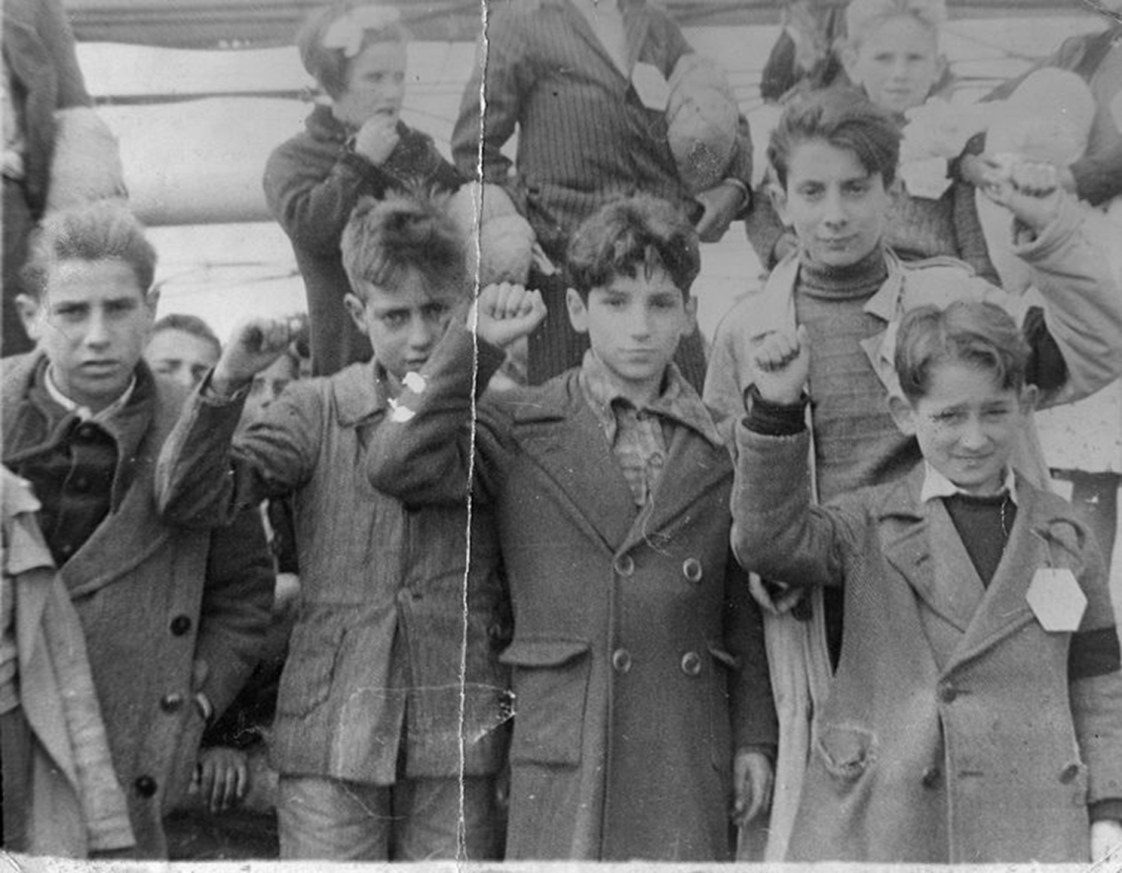
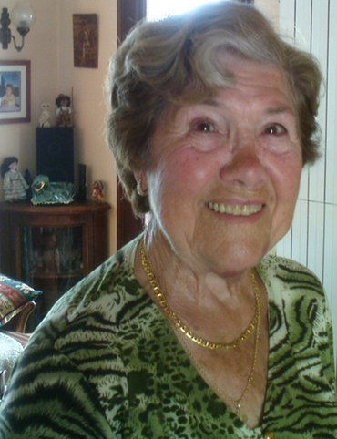
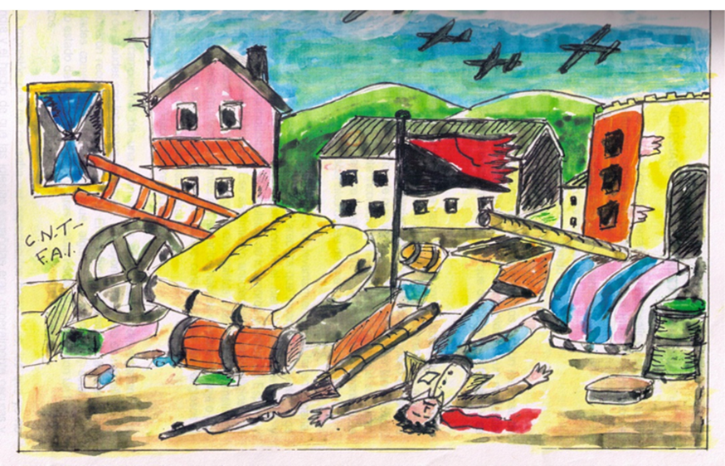
School of Modern Languages and Cultures
FACULTY OF ARTS
Oral History

Slide 12
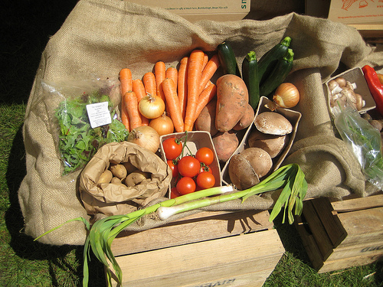
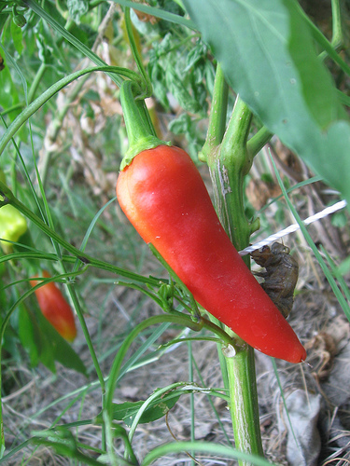
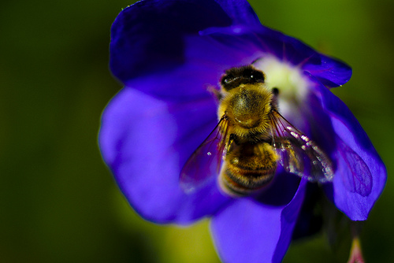
School of Modern Languages and Cultures
FACULTY OF ARTS
Student Production
Open
Ethical
Socially Constructed knowledge
Full-cycle complex student production process
Socially and personally relevant student outputs

Slide 13
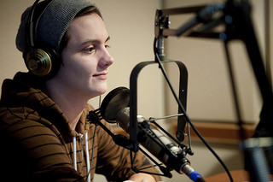
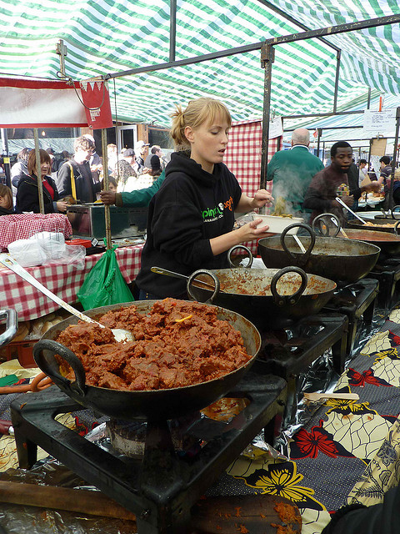
School of Modern Languages and Cultures
FACULTY OF ARTS
Educational Identities
The Role of Student in Research and Production: from pupil student to researcher, producer and public author.
And what about the lecturer-researcher?

Slide 14
School of Modern Languages and Cultures
FACULTY OF ARTS
HE, particularly Arts and Humanities, is not considered Real Life
The professions and the industry keep transforming HE

Slide 15
School of Modern Languages and Cultures
FACULTY OF ARTS
The practical acquisition of these Life Skills and the “transfer” should be done in the Educational Context of the Curriculum
Critical thinking and critical acting should aspire to transform the way we understand, and improve our lives and empathise with others.

Slide 16
School of Modern Languages and Cultures
FACULTY OF ARTS
Pictures from Flicker.com :
-Alaska_Dude (people in streetshow)
-Chris Willis (Close-up Bees) – 2 pictures
-Vancouver film school (boy headphones)
-xpgomes2 (food stall)
-Henna Lion (vegetables)
-AndyRobertsPhotos (vegbox)
Pictures from HumBox.ac.uk:
-Slide 4: OpenLIVES project (2012). An open collection of research data and teaching materials relating to Spanish migrant stories. JISC
Academic Sources:
Benckler, Y, (2011).The Penguin and the Leviathan: How Cooperation Triumphs over Self-Interest. Crown Business. New York
Benjamin, W. (1934). ‘The author as producer’ in New Left Review I/62, July-August 1970. http://www2.warwick.ac.uk/fac/arts/theatre_s/postgraduate/maipr/currentstudents/teaching_1112/warwick/st2/kobialka_reading_-_benjamin_w_-_the_author_as_producer.pdf [cited 23 January 2013]
Crome, K., Farrar, R. and O'Connor P. (2009). “What is Autonomous Learning?” Discourse. Vol. 9, N. 1. http://prs.heacademy.ac.uk/view.html/PrsDiscourseArticles/113 [cited 23 January 2013]
Healey, M. and Jenkins, A. (2009). Developing undergraduate research and enquiry. The Higher Education Academy. http://www.heacademy.ac.uk/assets/documents/research/DevelopingUndergraduateResearchandInquiry.pdf [cited 23 January 2013]
Hinchliffe G. and Jolly , A. (2009) Employer Concepts of Graduate Employability . The Higher Education Academy.
Martínez-Arboleda, Antonio (2013). “Liberation in OpenLIVES Critical Pedagogy: Empowerability and Critical Action”. Caracteres. Estudios culturales y críticos de la esfera digital vol. 2 (1) (21-5-2013) Pp. 112-127.http://revistacaracteres.net/revista/vol2n1mayo2013/liberation-in-openlives-critical-pedagogy-empowerability-and-critical-action/
Martínez-Arboleda, Antonio (2013). “The OpenLIVES Pedagogy: Oral History of Spanish Migration, Collaborative Student Research, Open Practice and Transformational Education for a Radically Better Society”. In INTED2013 Proceedings. IATED (International Association of Technology, Education and Development): pp. 208-217
Molesworth, M., Scullion, R., and Nixon, E. (eds) (2011). The Marketisation of Higher Education and Student-as-a-consumer. Routledge. London and New York.

